Slide 1
Domina la Graph API, domina el mundo
Luis Mañez (MVP)
Notes:
This slide is mandatory. Please do not remove.

Slide 2
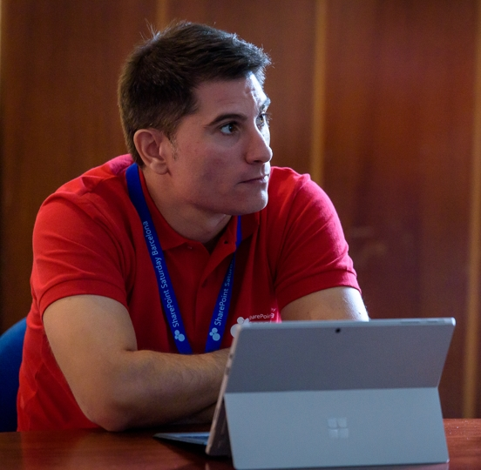
Luis Mañez
Cloud architect, SharePoint architect, Developer
ClearPeople LTD (U.K)
https://medium.com/inherits-cloud
@luismanez
Office Development MVP. About 15 years of experience working with Microsoft Technologies. MS Certified specialist in Developing Azure and SharePoint MCPD. Passionate about technology, blogger, technical writer and MS community active member.

Slide 3
Notes:
This slide is mandatory. Please do not remove and try to use it during Q&A at the end of your session. Thank you!

Slide 4
WiFi Keys for Attendees
Connect to the wireless network MSFT_GUEST
Login details for the wireless network:
Guest Username O365Sat@outlook.com
Guest Password: 0195

Slide 5
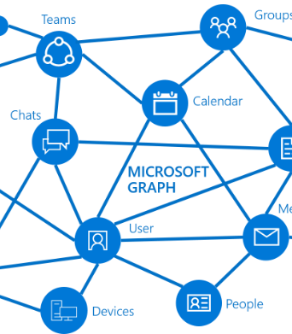
Que es MS Graph?

Slide 6
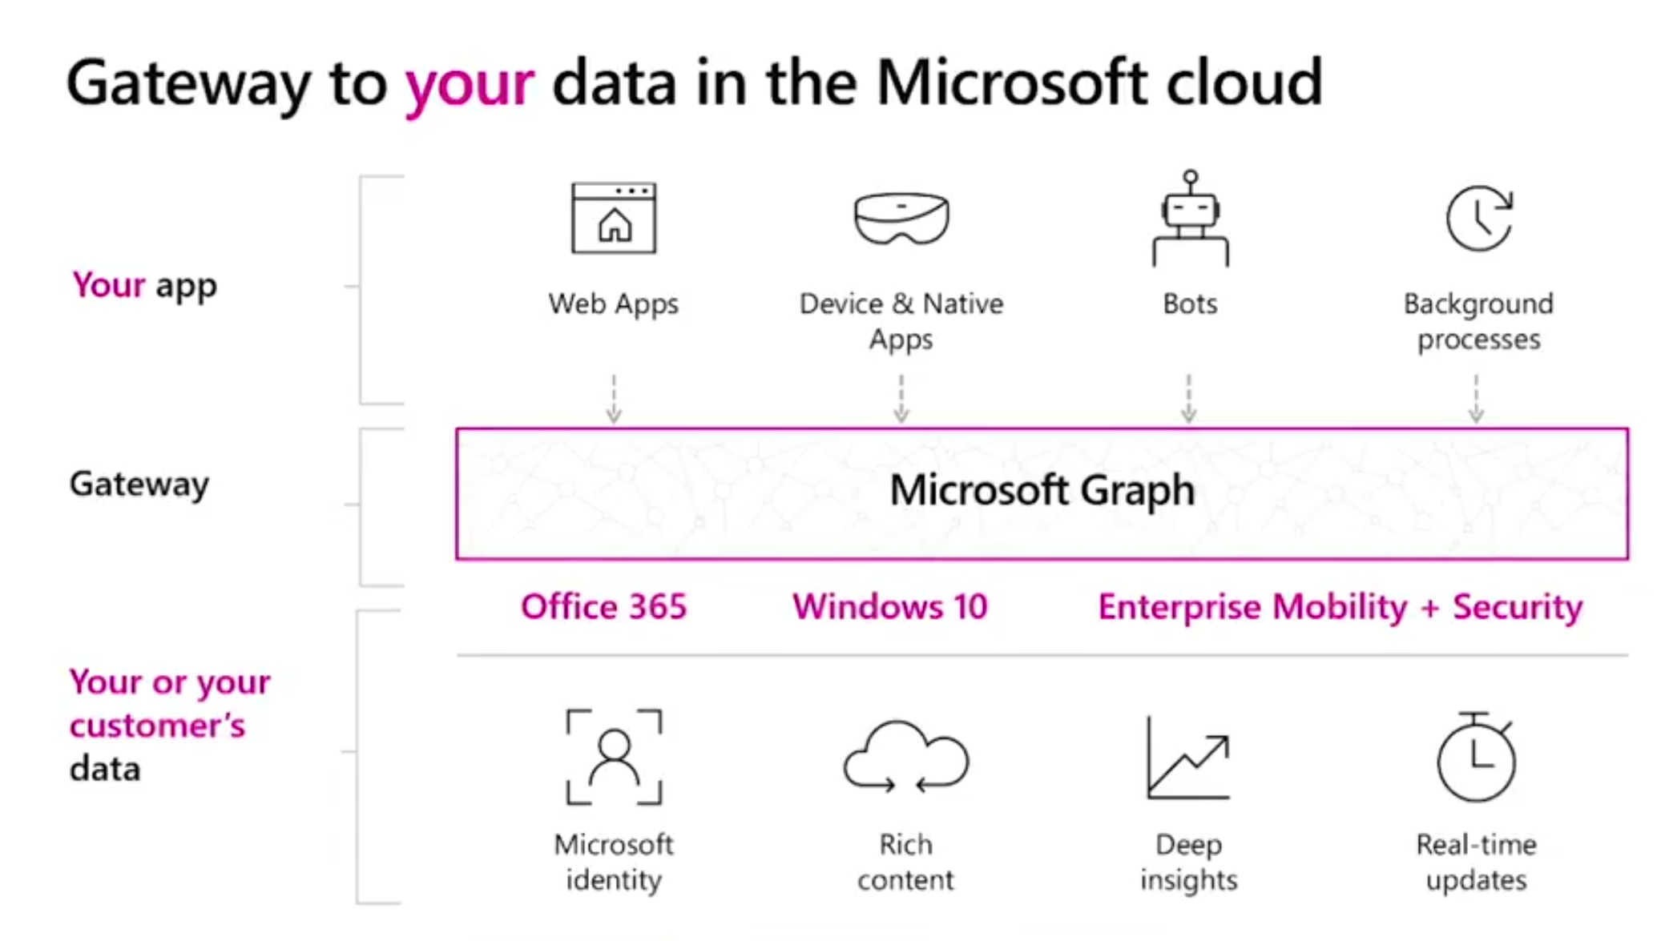

Slide 7
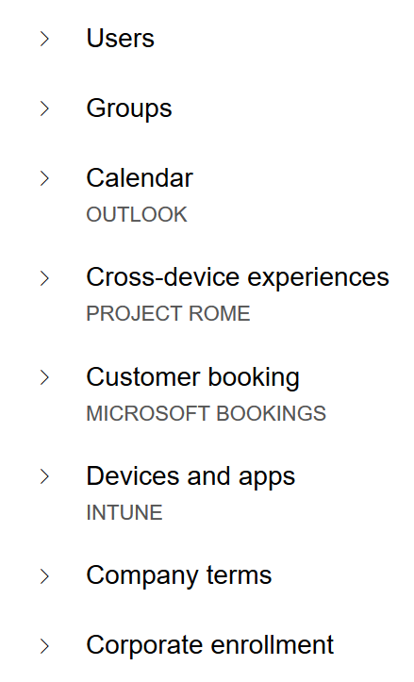
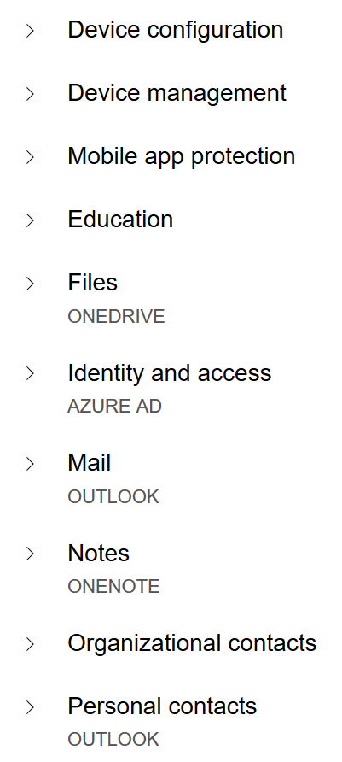
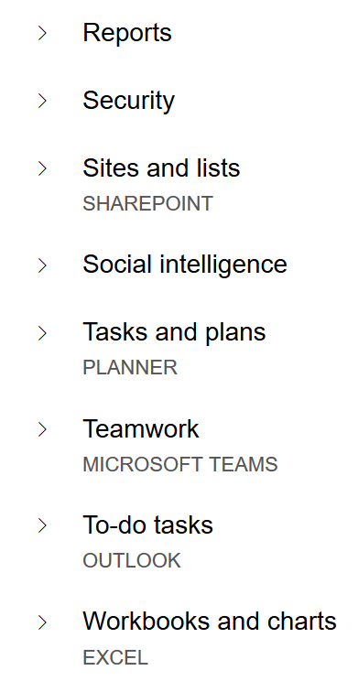
MS Graph Endpoints

Slide 8
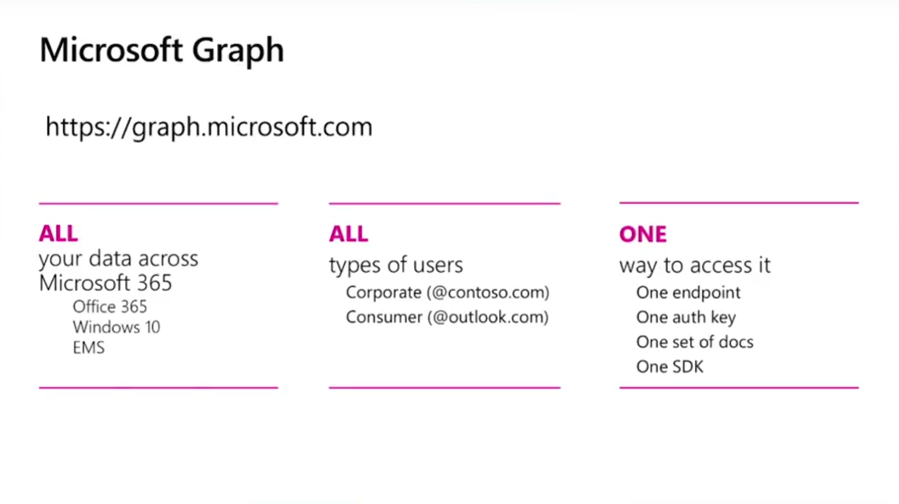

Slide 9

Azure AD Authentication

Slide 10
Azure AD Conceptos
Azure AD Auth esta basado en oAuth 2.0 y OpenIdConnect
MS Graph require un Access Token de Azure AD para ser consumida
Registrar App en Azure AD
Azure V1 vs v2 Endpoint
Asignar permisos
Consent Framework

Slide 11
Azure AD v1 vs v2 endpoints
V1 endpoint
V2 endpoint
Portal | portal.azure.com | apps.dev.microsoft.com
Accounts supported | Work / School | Work / School / Personal
Set of APIs | ALL (Graph, SharePoint, Intune, Skype…) | Only Graph API
Multiple Platforms in App | No | Yes
Scopes | Resource | Request
Consents | Static | Dynamic
Multi-Tenant | Requires configuration | By default
Nuget Package | Microsoft.IdentityModel.Clients.ActiveDirectory | Microsoft.Identity.Client
https://docs.microsoft.com/en-us/azure/active-directory/develop/active-directory-v2-limitations
https://docs.microsoft.com/en-us/azure/active-directory/develop/active-directory-v2-compare

Slide 12










Escenarios de consumo

Slide 13
Escenarios de consumo
Mobile and native apps | Web apps and web APIs | Integrate directly with protocols
Add sign-in to an iOS application | Add sign-in to a JavaScript Single Page Application (SPA) | Register an application
Add sign-in to an Android application | Add sign-in to a ASP.NET application | Mobile applications with the OAuth 2.0 protocol
Add sign-in to a Windows Desktop application | Add sign-in to a ASP.NET Core Web application | Web applications with the OpenID Connect protocol
Add sign-in to a multi-platform Xamarin application | Add sign-in to a Node.js web application | JavaScript SPAs with the OpenID Connect protocol
 | Protect an ASP.NET Web API | Daemon applications with the OAuth 2.0 client credentials flow
 | Protect an ASP.NET Core Web API
https://docs.microsoft.com/en-us/azure/active-directory/develop/active-directory-appmodel-v2-overview
https://docs.microsoft.com/en-us/azure/active-directory/develop/active-directory-v2-protocols

Slide 14


Demo…
…gorgon

Slide 15

MS Graph Extensions

Slide 16
MS Graph extensions
Permite almacenar nuestros propios datos en MS Graph.
Ejemplo: ampliar los datos de un usuario con “su color favorito”
Open extensions
Estructura flexible
Key-Value list
Schema extensions
Datos “tipados”
Validacion de tipos

Slide 17
Demo…
…gorgon

Slide 18

Batch Requests

Slide 19
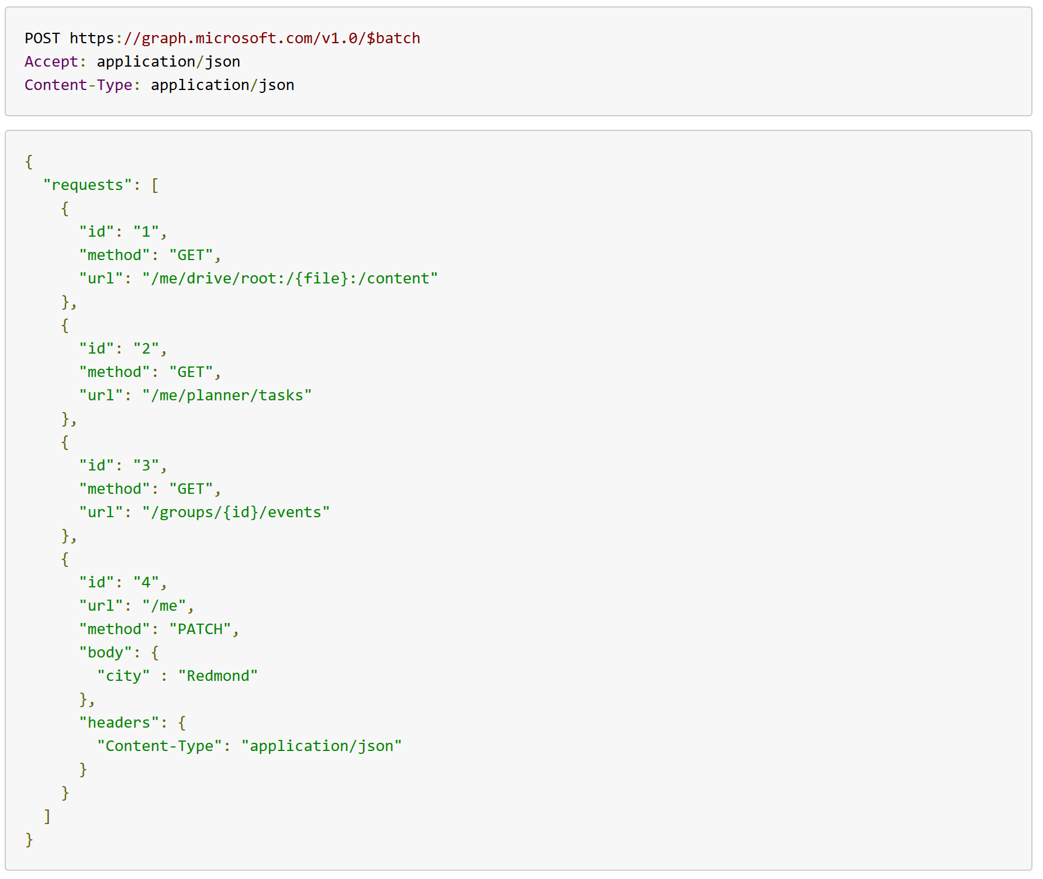
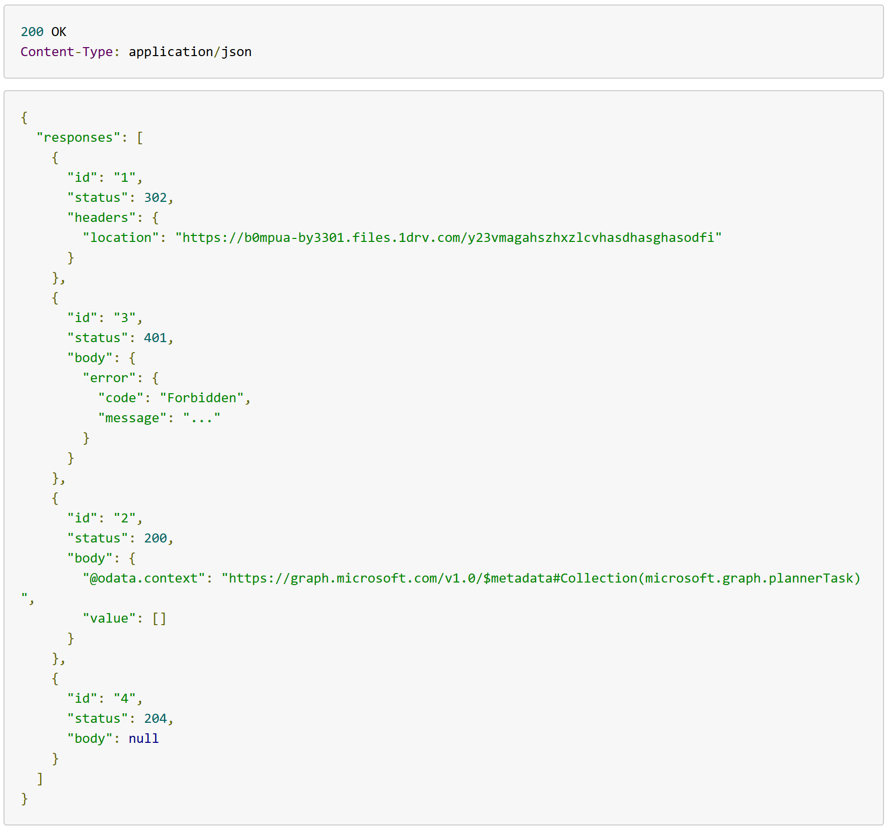
Batch Request / Response

Slide 20
Limitaciones Batch requests
No se pueden anidar peticiones Batch
No es transaccional
URIs deben ser relativas
Máximo 20 peticiones en Batch
Dependencias simples “dependsOn”

Slide 21
Demo…
…gorgon

Slide 22
https://github.com/luismanez/sp-saturday-madrid-2018

Slide 23

Tips & Tricks

Slide 24

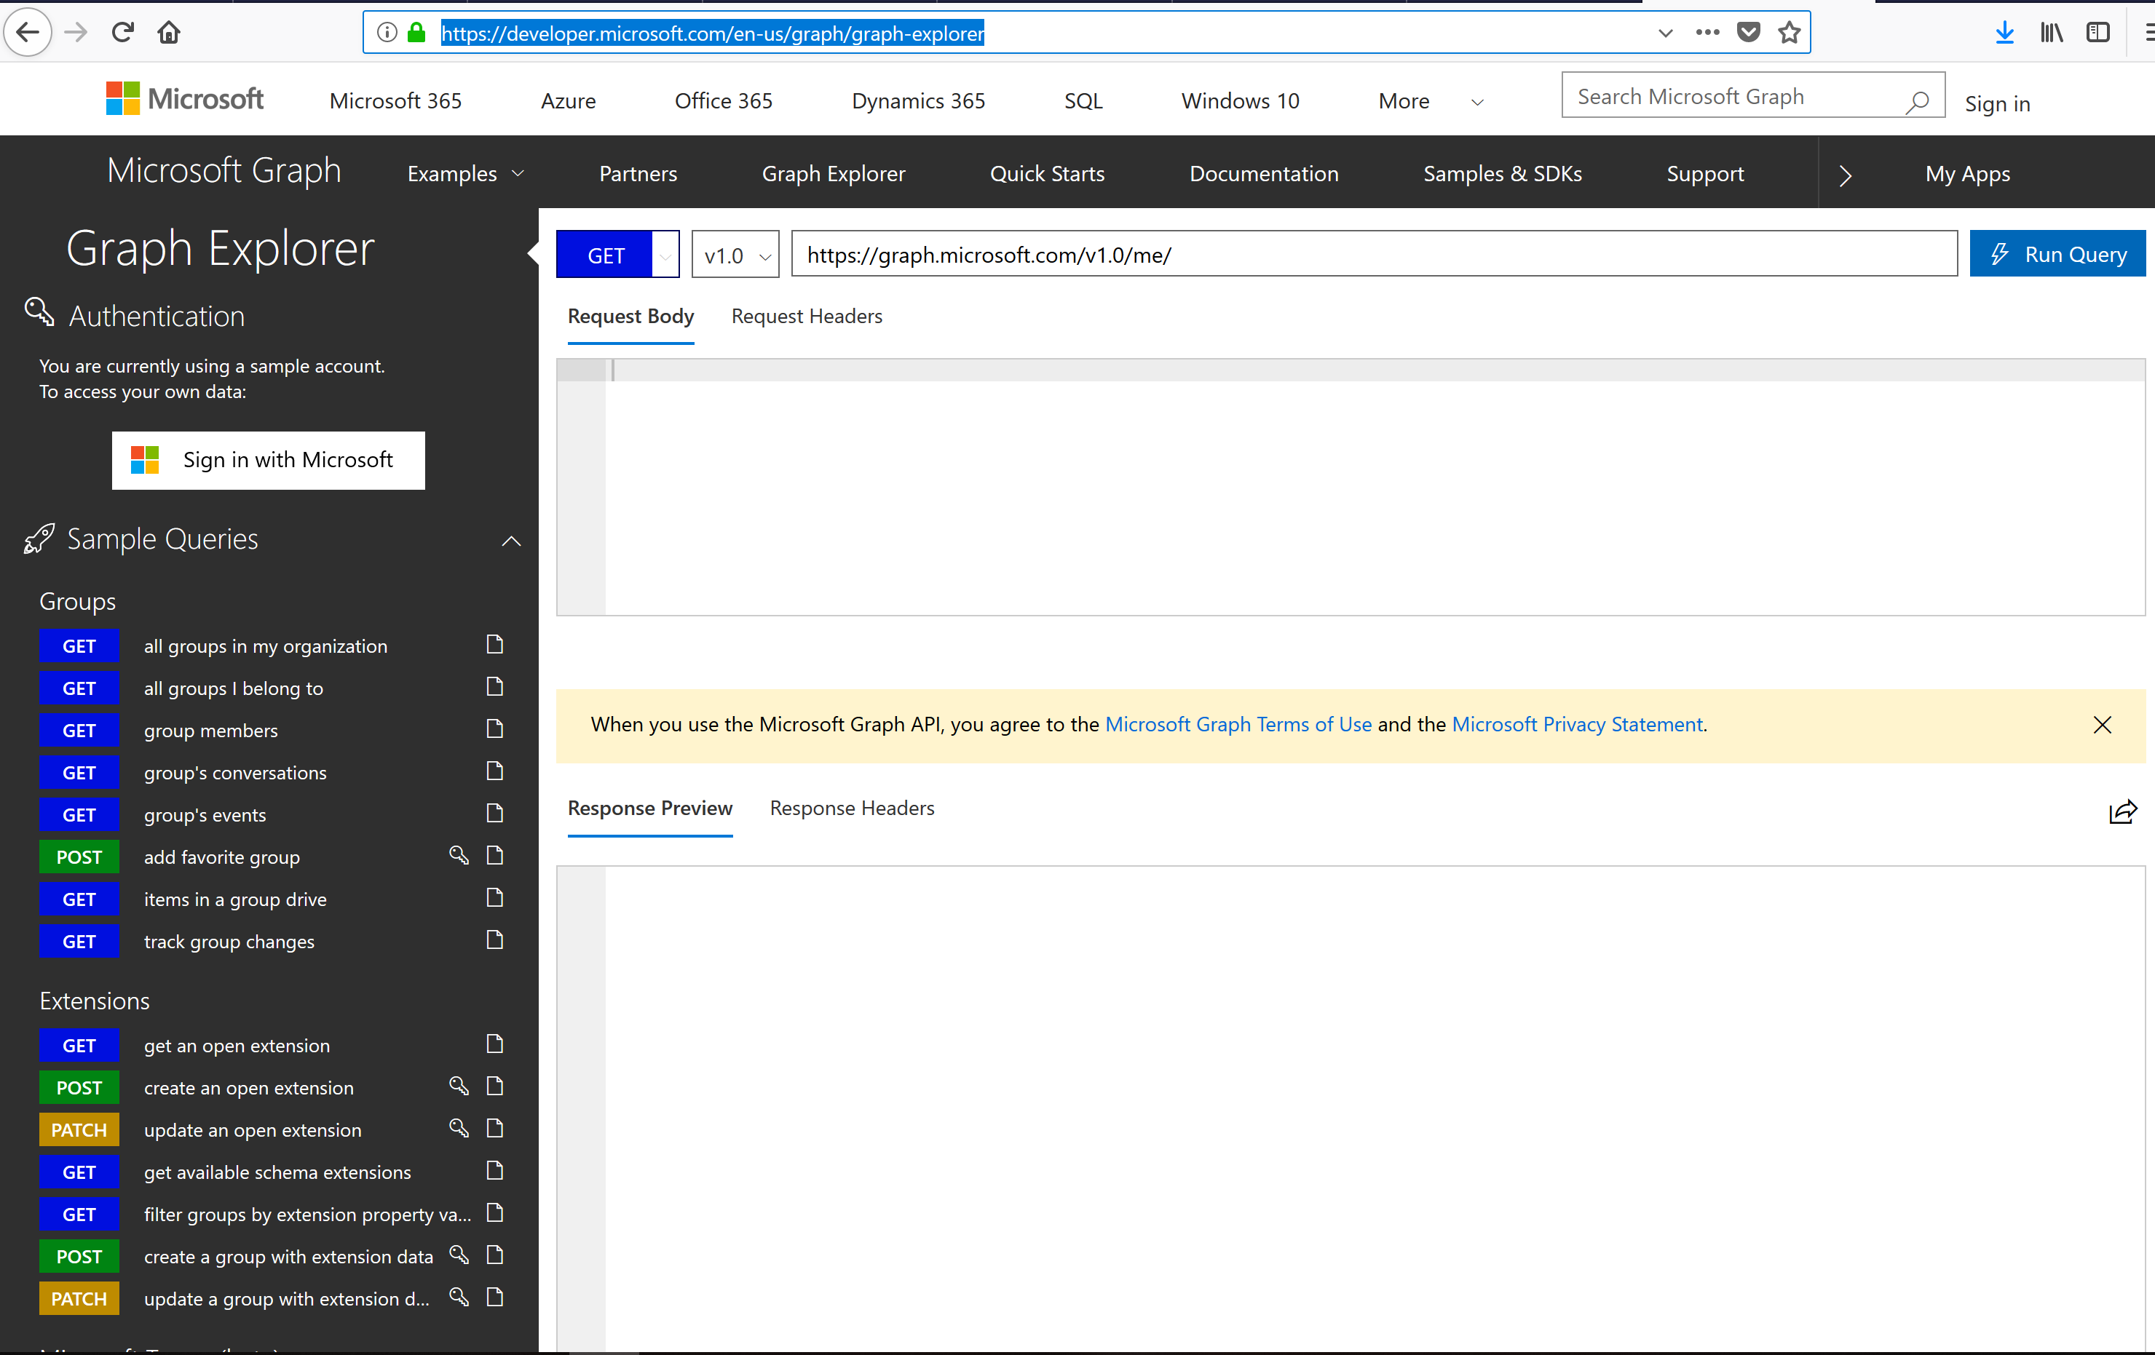
Graph explorer es tu “BFF”
1

Slide 25
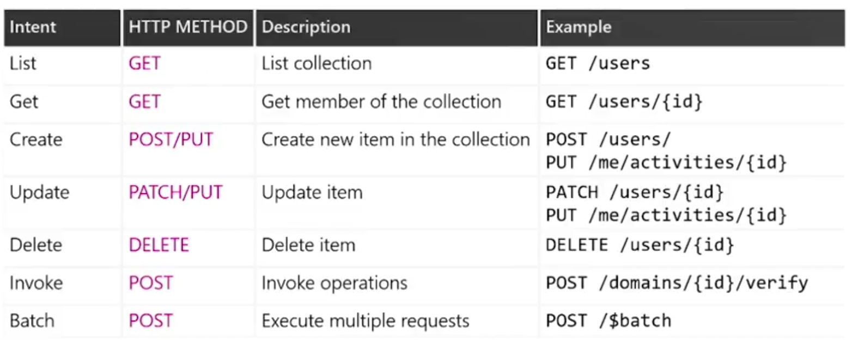
Los 7 magnificos (operaciones)
2

Slide 26
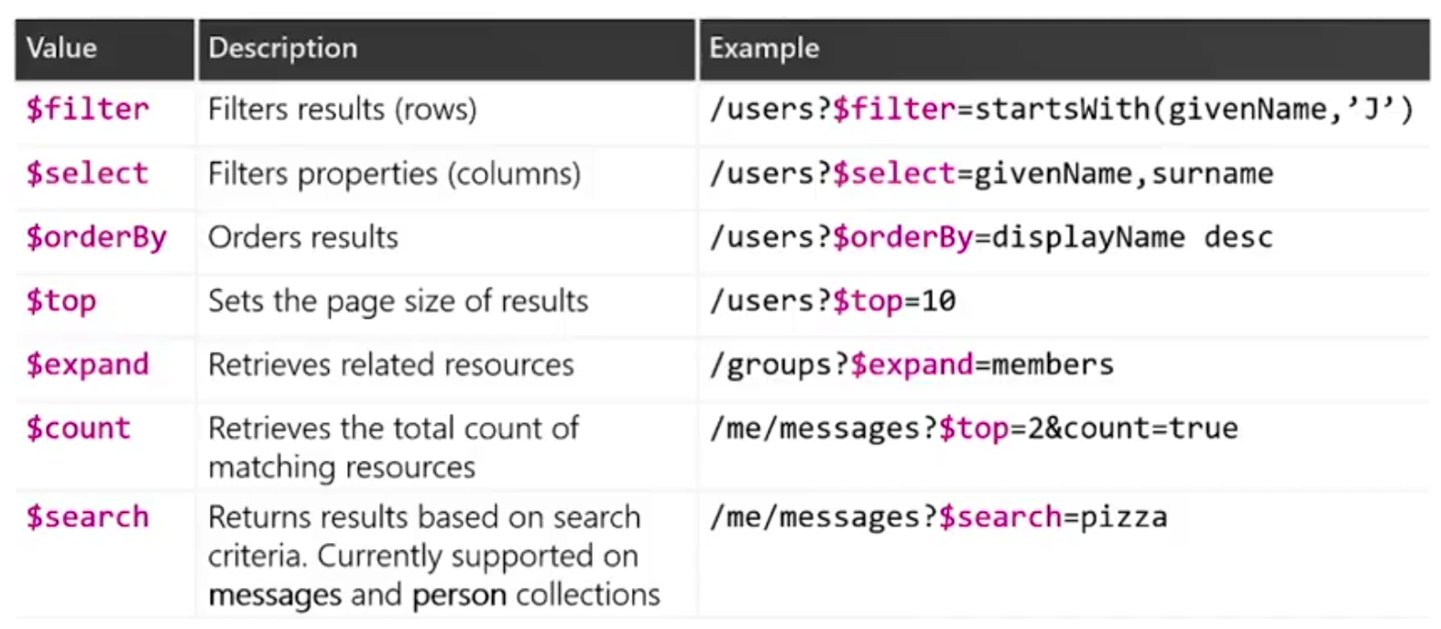
Los 7 magnificos (query parameters)
3

Slide 27
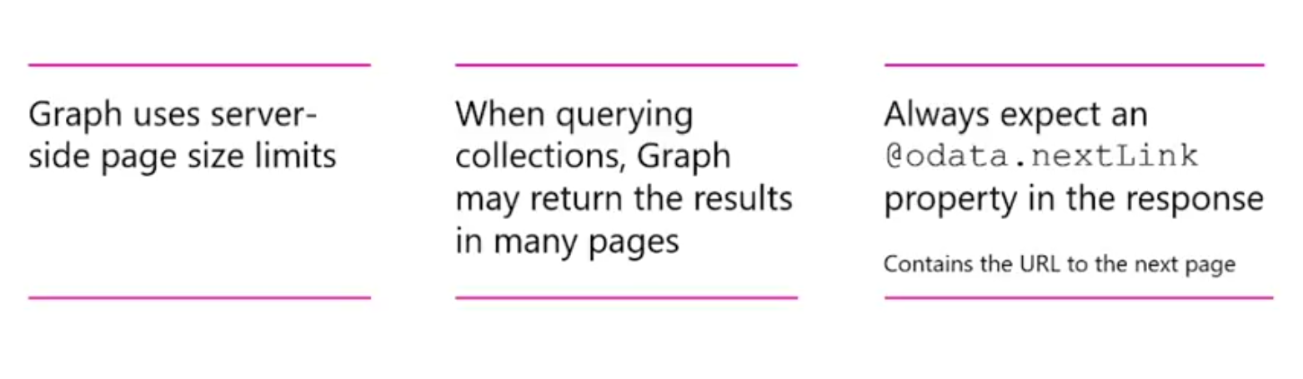
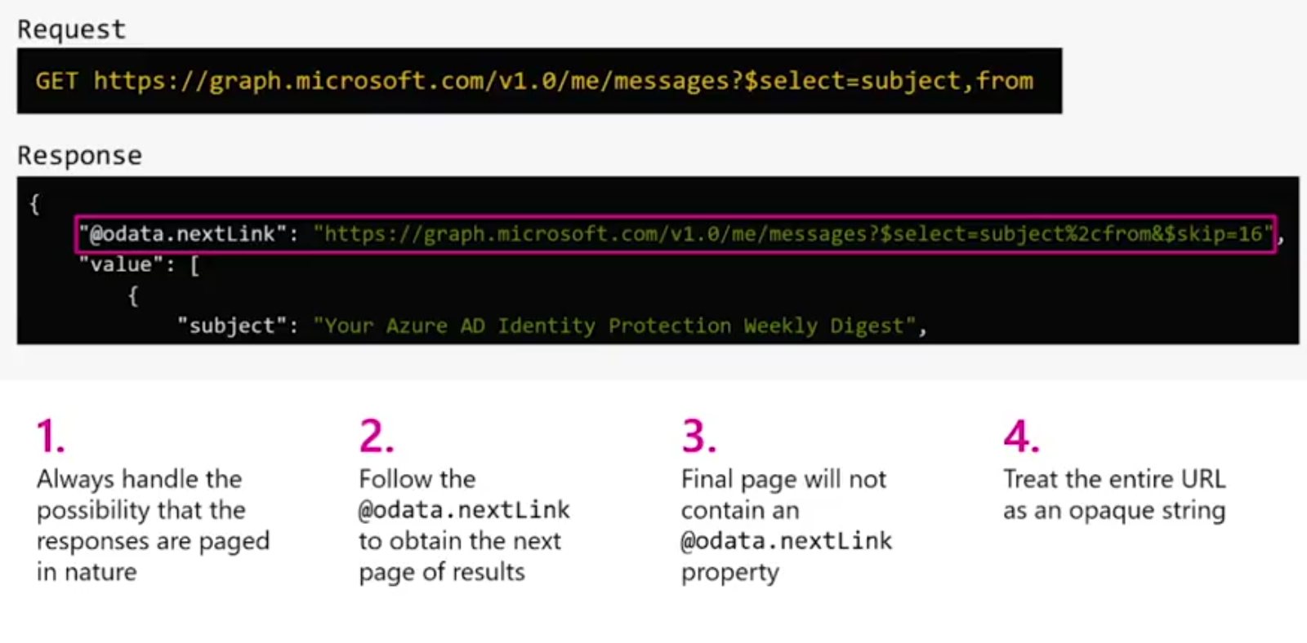
Server-side pagination
4

Slide 28
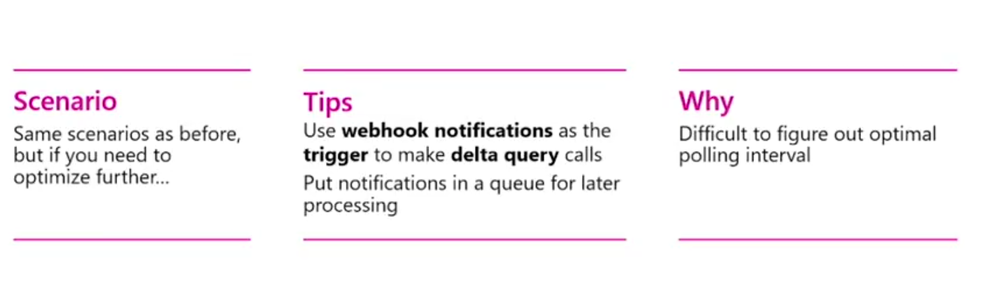
Track changes: webhooks + delta queries
5

Slide 29
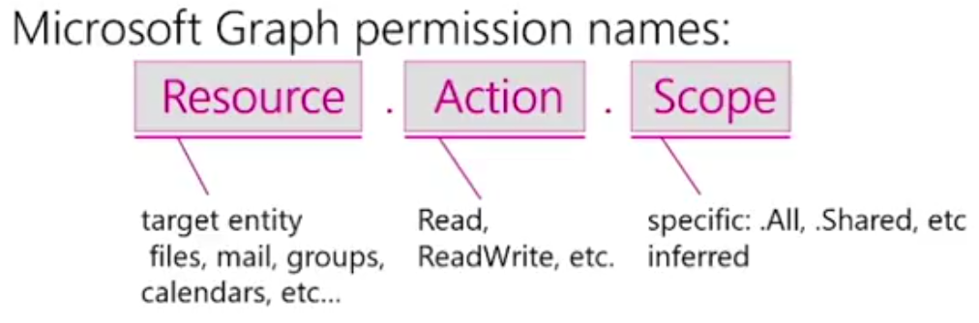
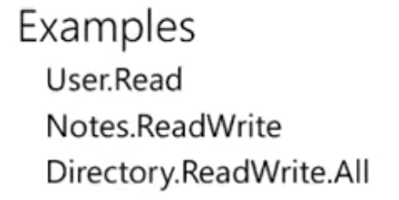
Use least privileges
6

Slide 30
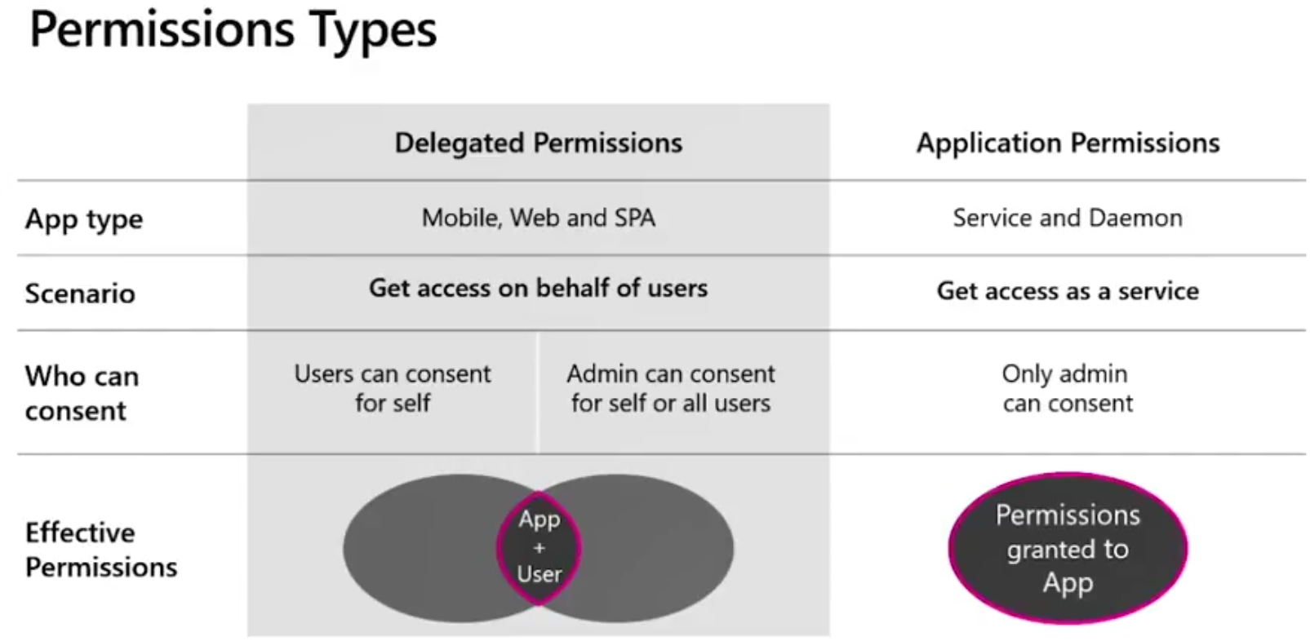
Use least privileges
6

Slide 31
Resources
MS Graph main page:
https://developer.microsoft.com/en-us/graph
MS Graph explorer:
https://developer.microsoft.com/en-us/graph/graph-explorer
Azure AD MS Graph samples
https://github.com/Azure-Samples?utf8=%E2%9C%93&q=graph&type=&language=
Build 2018 MS Graph Videos:
https://channel9.msdn.com/Events/Build/2018?sort=status&direction=desc&tag%5B0%5D=microsoft%2Bgraph&page=3

Slide 32
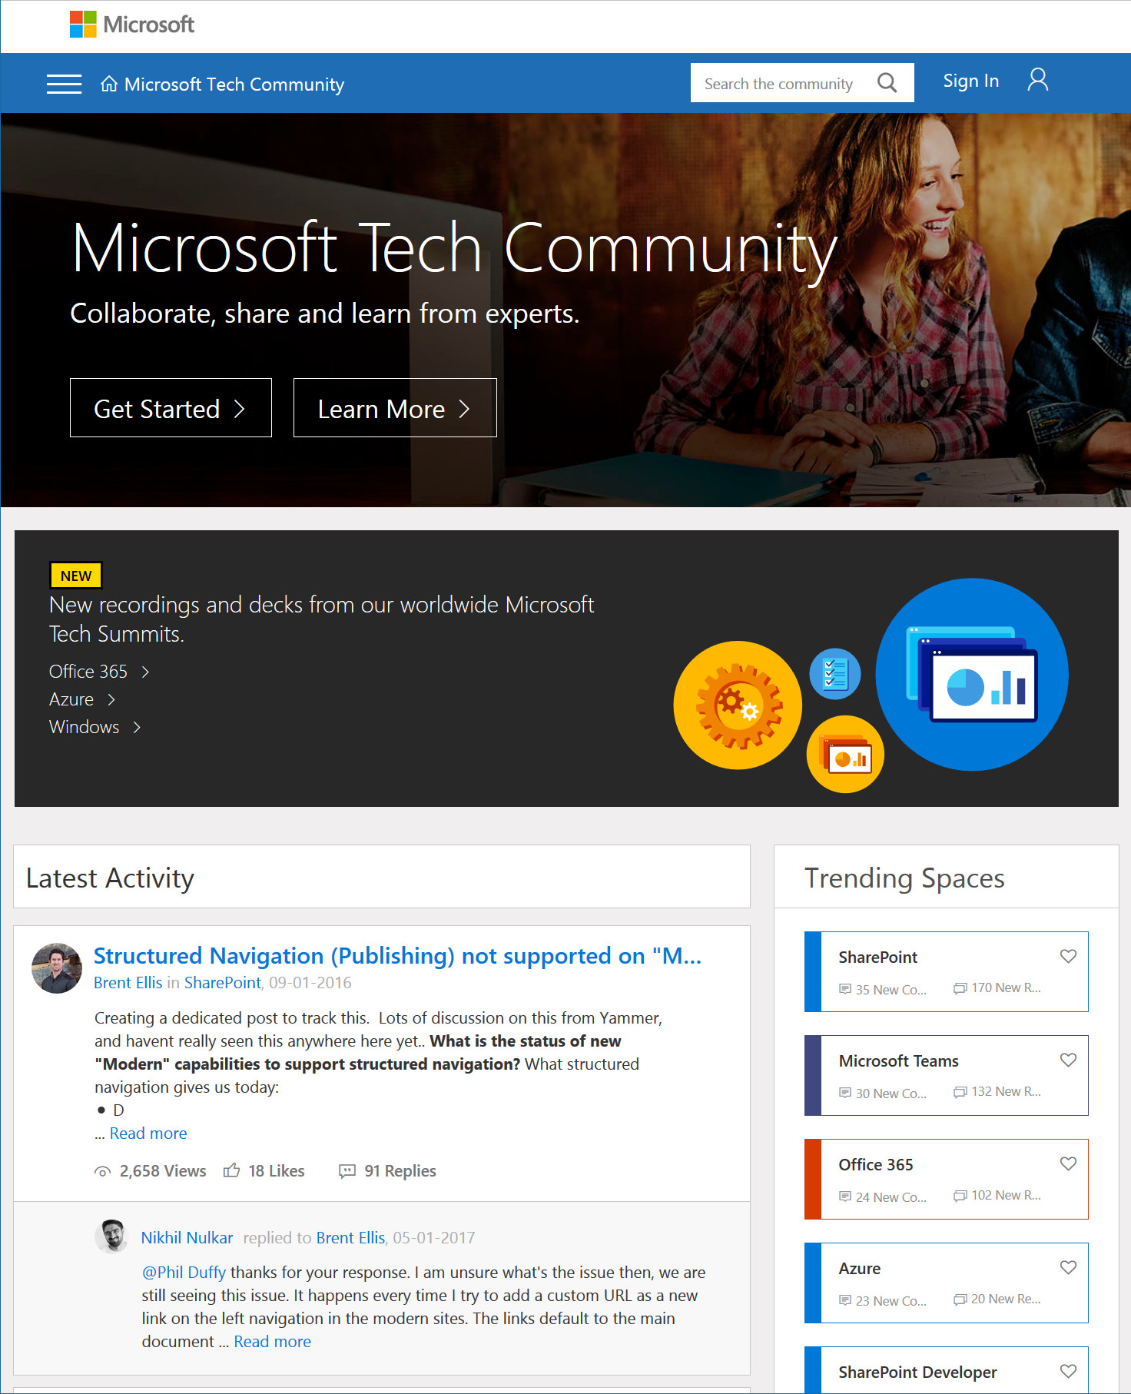
Microsoft Tech Community
techcommunity.microsoft.com
One Microsoft community for IT Pros and tech enthusiasts to learn from experts on Microsoft products
Trusted resource for news, best practices and answers from Microsoft product teams and MVPs
Join today! It’s free – sign in with your Microsoft Account.

Slide 33
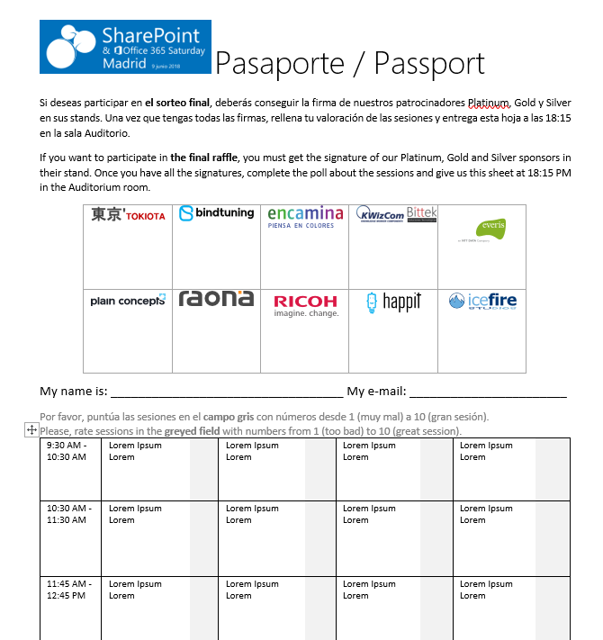


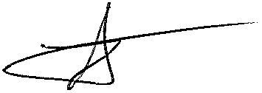




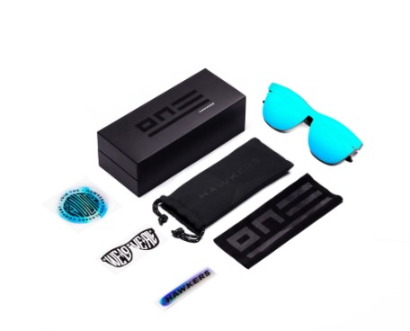







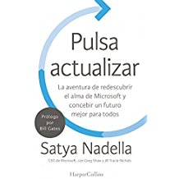
Raffle
Please, fill your SP & Office 365 Saturday Madrid passport if you want to participate.
You can win one of these gifts:
Please, fill your SP & Office 365 Saturday Madrid passport if you want to participate.
You can win one of these gifts:
Odor
Odor@winterfell.com
10
9
2x
2x
8

Slide 34
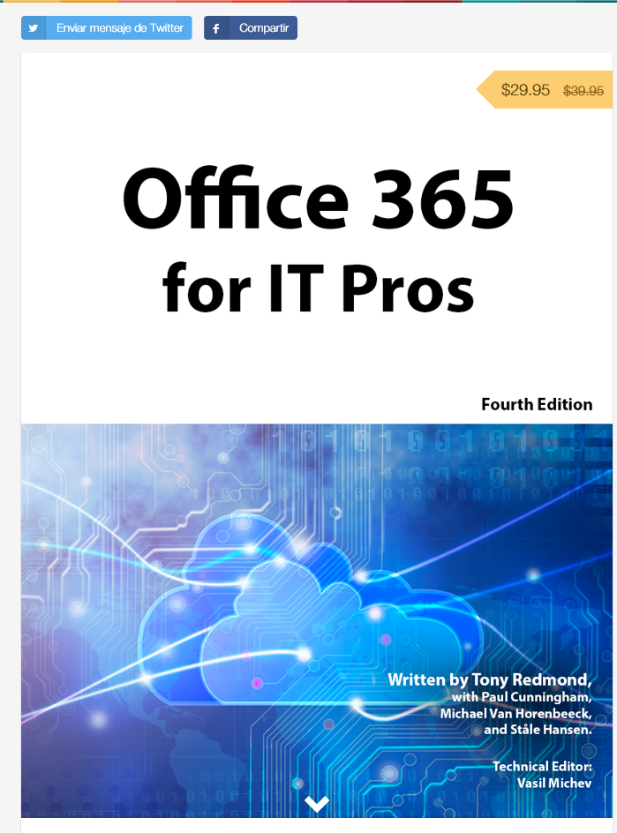
Office 365 for IT Pros
Get a discount of $10 buying the book here: https://gumroad.com/l/O365IT/spsspain

Slide 35
Notes:
This slide is mandatory. Please do not remove and try to use it during Q&A at the end of your session. Thank you!

Slide 36
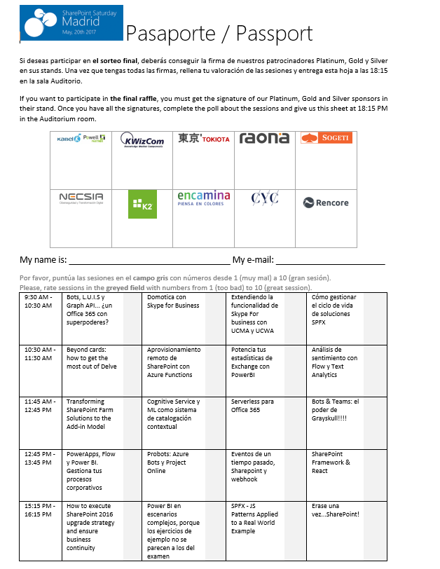
Raffle
Please, fill your SP & Office 365 Saturday Madrid passport if you want to participate.
You can win one of these gifts:
Odor
Odor@winterfell.com
10
9
8

Slide 37
Hide Slide
Notes:
Open: Visual Studio Project, VS Code rest request, Fiddler (no capturing), Azure portal, MS Graph Explorer signed in
Demo 1: Registro Azure AD Apps + GetGroups – 9:15
Demo 2: Get Me – 6:37
Demo 3: Open extensions – 3:10
Demo 4: Schema extensions – 5:10
Demo 5: Batch request with Fiddler – 6:30
Total Demos aprox 35’

